Slide 1
Session 5 (of 24)
PGR112 Objectorientert programmering Marcus Alexander Dahl / marcusalexander.dahl@kristiania.no

Slide 2
Lecture lecture = new Lecture(5);
lecture.printGoals();
Go more in depth using the Scanner-class, from validating input to understanding how it actually works
Debugging our code to understand what happens
Logging information during development
Writing a simple test and explore that briefly

Slide 3
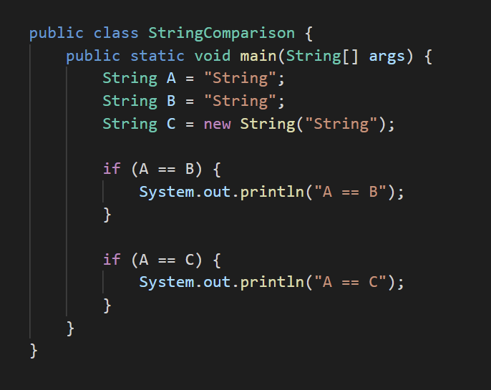
String – taking a closer look
Strings in Java are immutable. You can read more here.
Can be seen as an array of the primitive data type char
Be aware, as we should use A.equals(B) and A.equals(C) instead!

Slide 4
Java I/O
Input and output of data
For input, we have so far used System.in as an argument to the constructor of the Scanner-class
Available as an import from java.util.Scanner
For output, we have so far used System.out and its available methods such as print, println, printf.
Respectively, they are the following types: InputStream and PrintStream.

Slide 5
Java I/O – Scanner
Taking a closer look at the Scanner we have used to read input so far
It works by reading and parsing input data, creating tokens by splitting up the data using a delimeter, by default using white space (space, enter, tab, etc)
It has different methods which allows us to detect the state of the scanner, seeing as the Scanner-class is a state machine.
Our program will stop while waiting on input!
Remember to close our scanner, we are working with streams!

Slide 6
Java I/O – Scanner
Let us explore by writing some code…

Slide 7
Java I/O – Creating a (terminal) menu
Into IntelliJ we go!

Slide 8
Problems
For a Java-program to run, it must be compiled first. The compiler makes sure that the programmer is following the rules that the compiler expects to be followed.
The compiler will display errors during compilation and display where in our code an error / exception presented itself.
There can still be errors when running our code and is often due to a logical error (if statements, loops, indexing, etc.) or user input.
Where should we start when errors occur, or we are stuck?

Slide 9
Debugging
A simple way of debugging is to simply use the terminal, as in printing out information to the terminal so that we as the programmer can read it
This can get really messy with bigger code bases, and especially when we’re dealing with many classes and methods.
IntelliJ has a powerful debugger!

Slide 10
Debugger
It is not only IntelliJ that has a debugger, any IDE with any dignity and respect for itself, do have a debugger.
What does the debugger allow us to do? We can step into our code and run it step by step.
During each step, we can examine both local variables and fields.
A little demonstration;
You can read more about basics of Debugger in IntelliJ here.

Slide 11
Writing a simple (for now) test
Tests can make sure your code doesn’t break old functionality when new functionality is added.
Testing alone is a big topic, but for now we will keep it simple with assertions, making sure our data stays and acts as we expect it to do.
Let create a simple test and explore some basic concepts when setting up tests.

Slide 12
Before we end
Goals for this sessions:
I understand more about how the Scanner works
I understand in simple terms that we are working with streams of data

Slide 13
[Bonus]: Newer Java-feature: Records
Instead of using classes to store data, as in, a class being used only as data storage using its fields, we can use records instead.
Data is immutable, so there are no setters, only getters with the same name as the field, instead of a get prefix.
Values are declared when given to the constructor.
Let us explore by coding an example together

